Slide 1
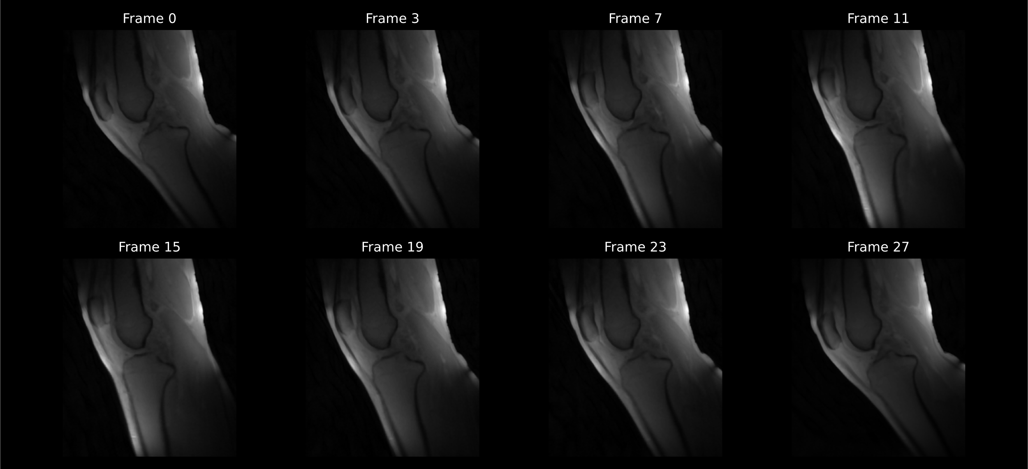
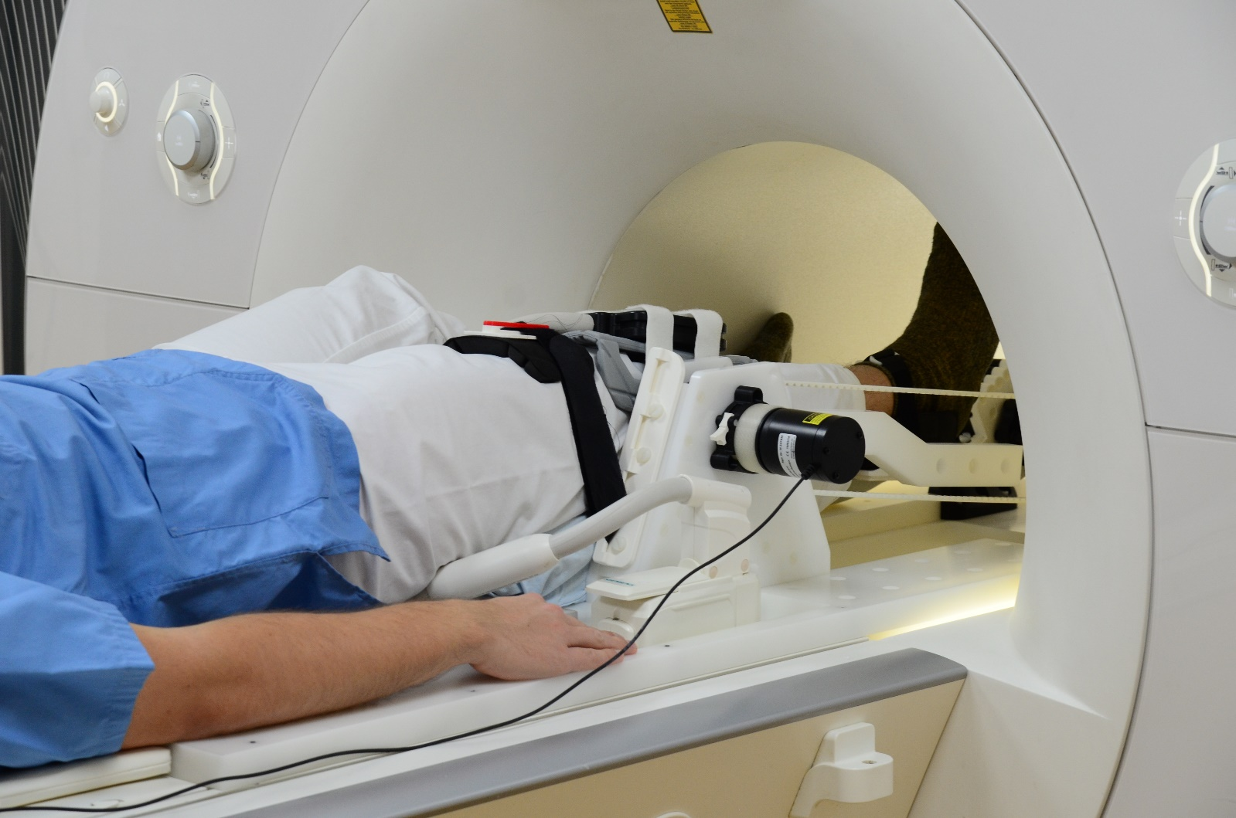
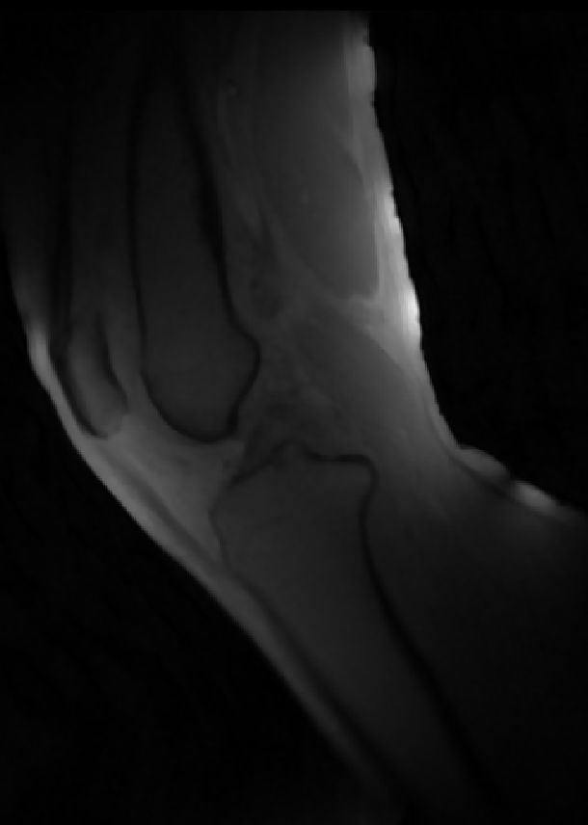
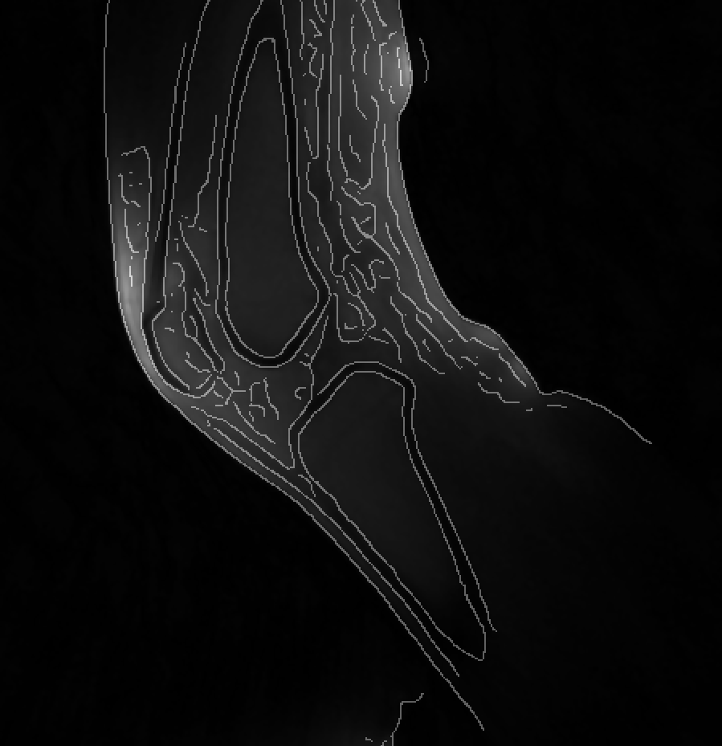
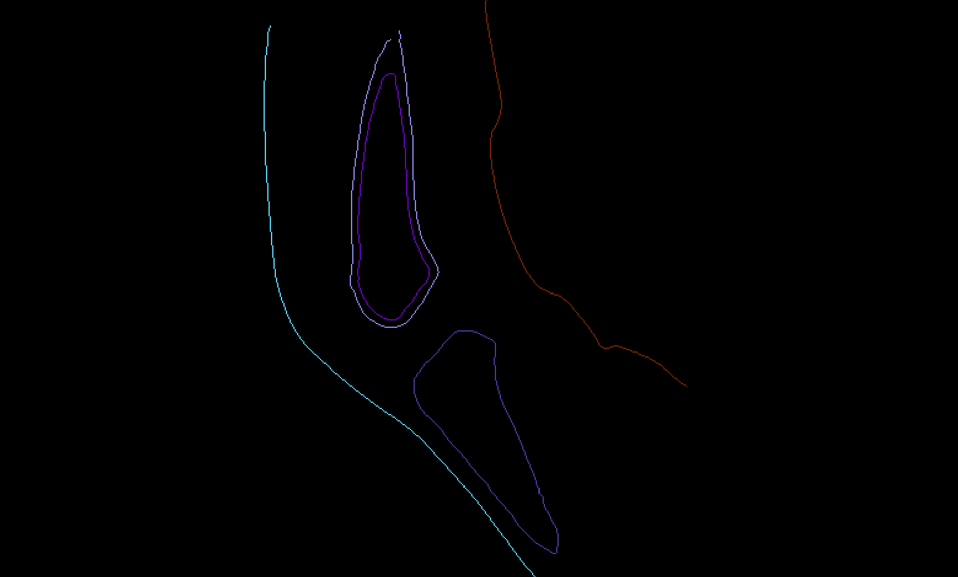
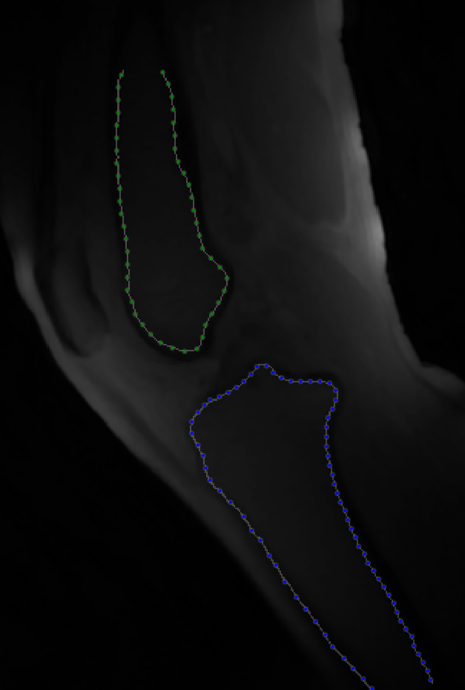
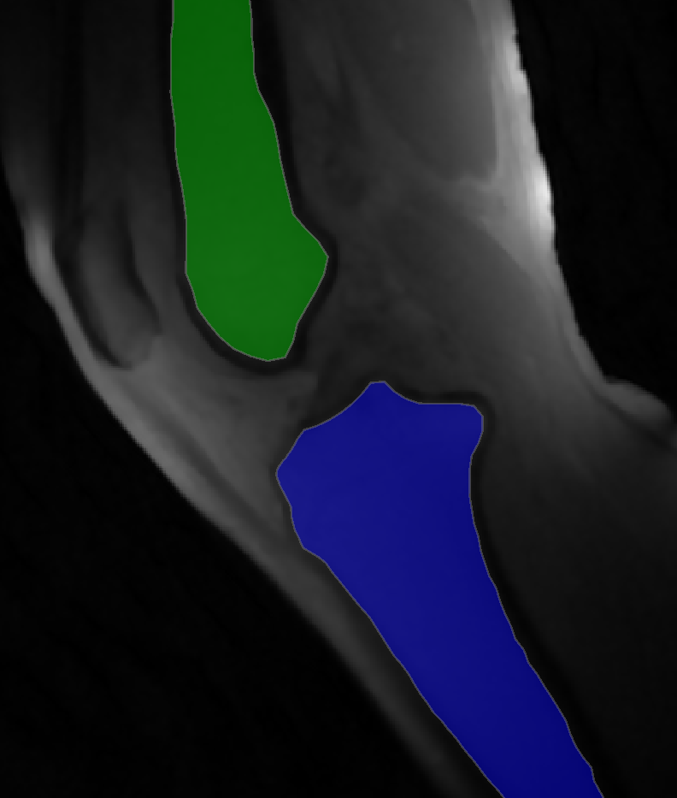
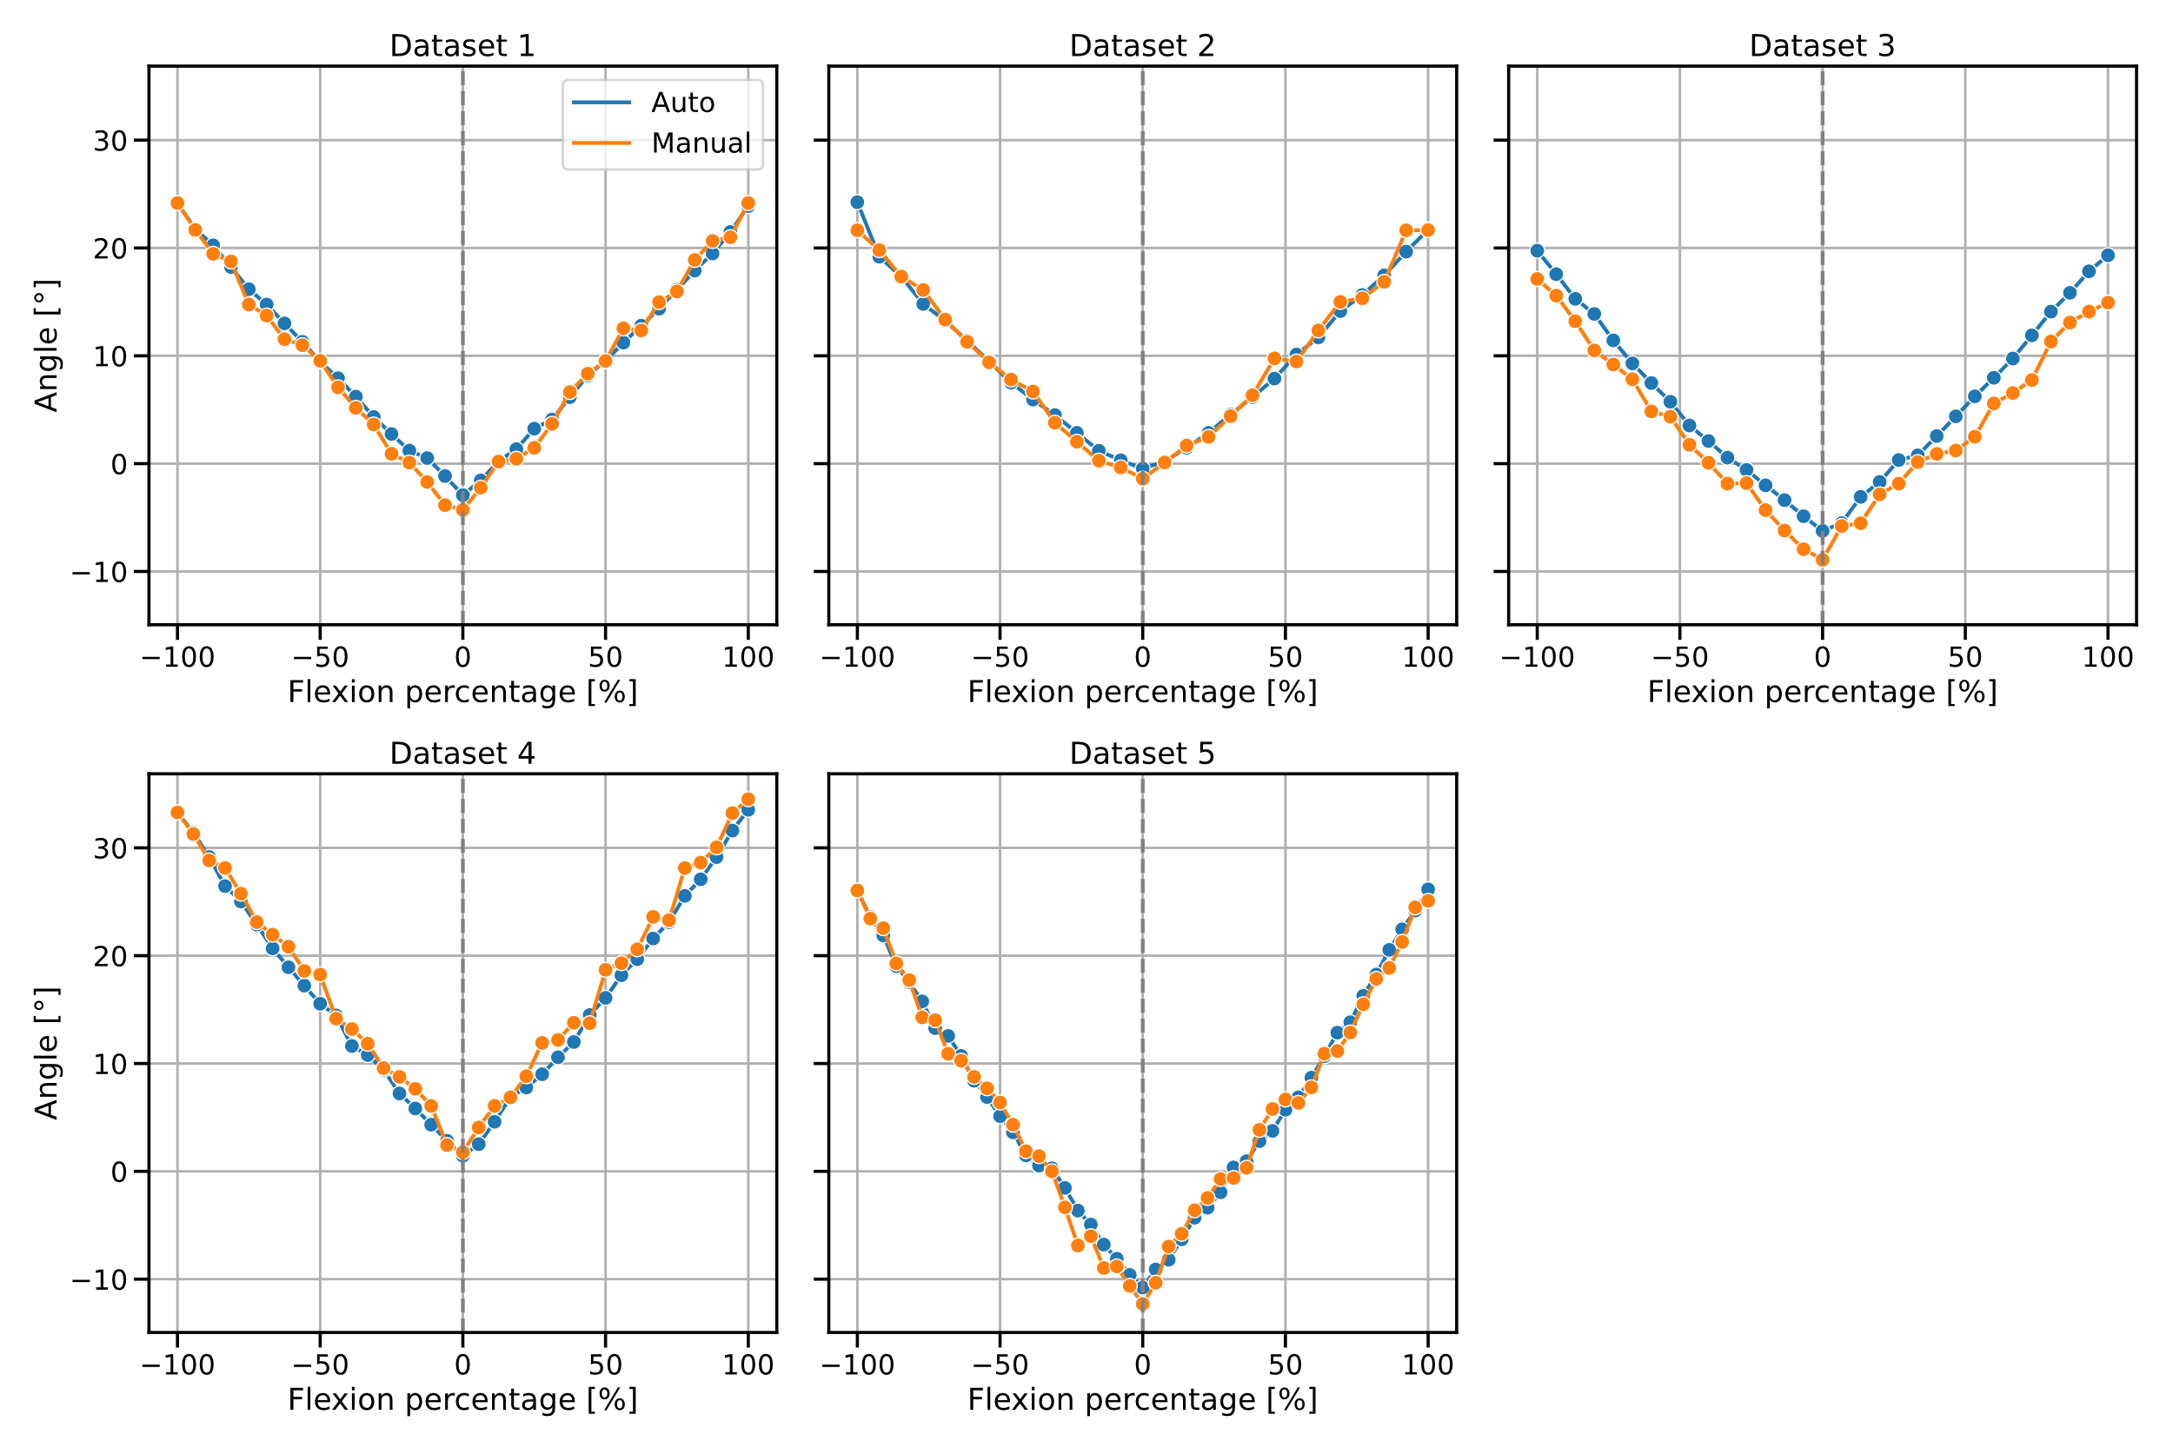
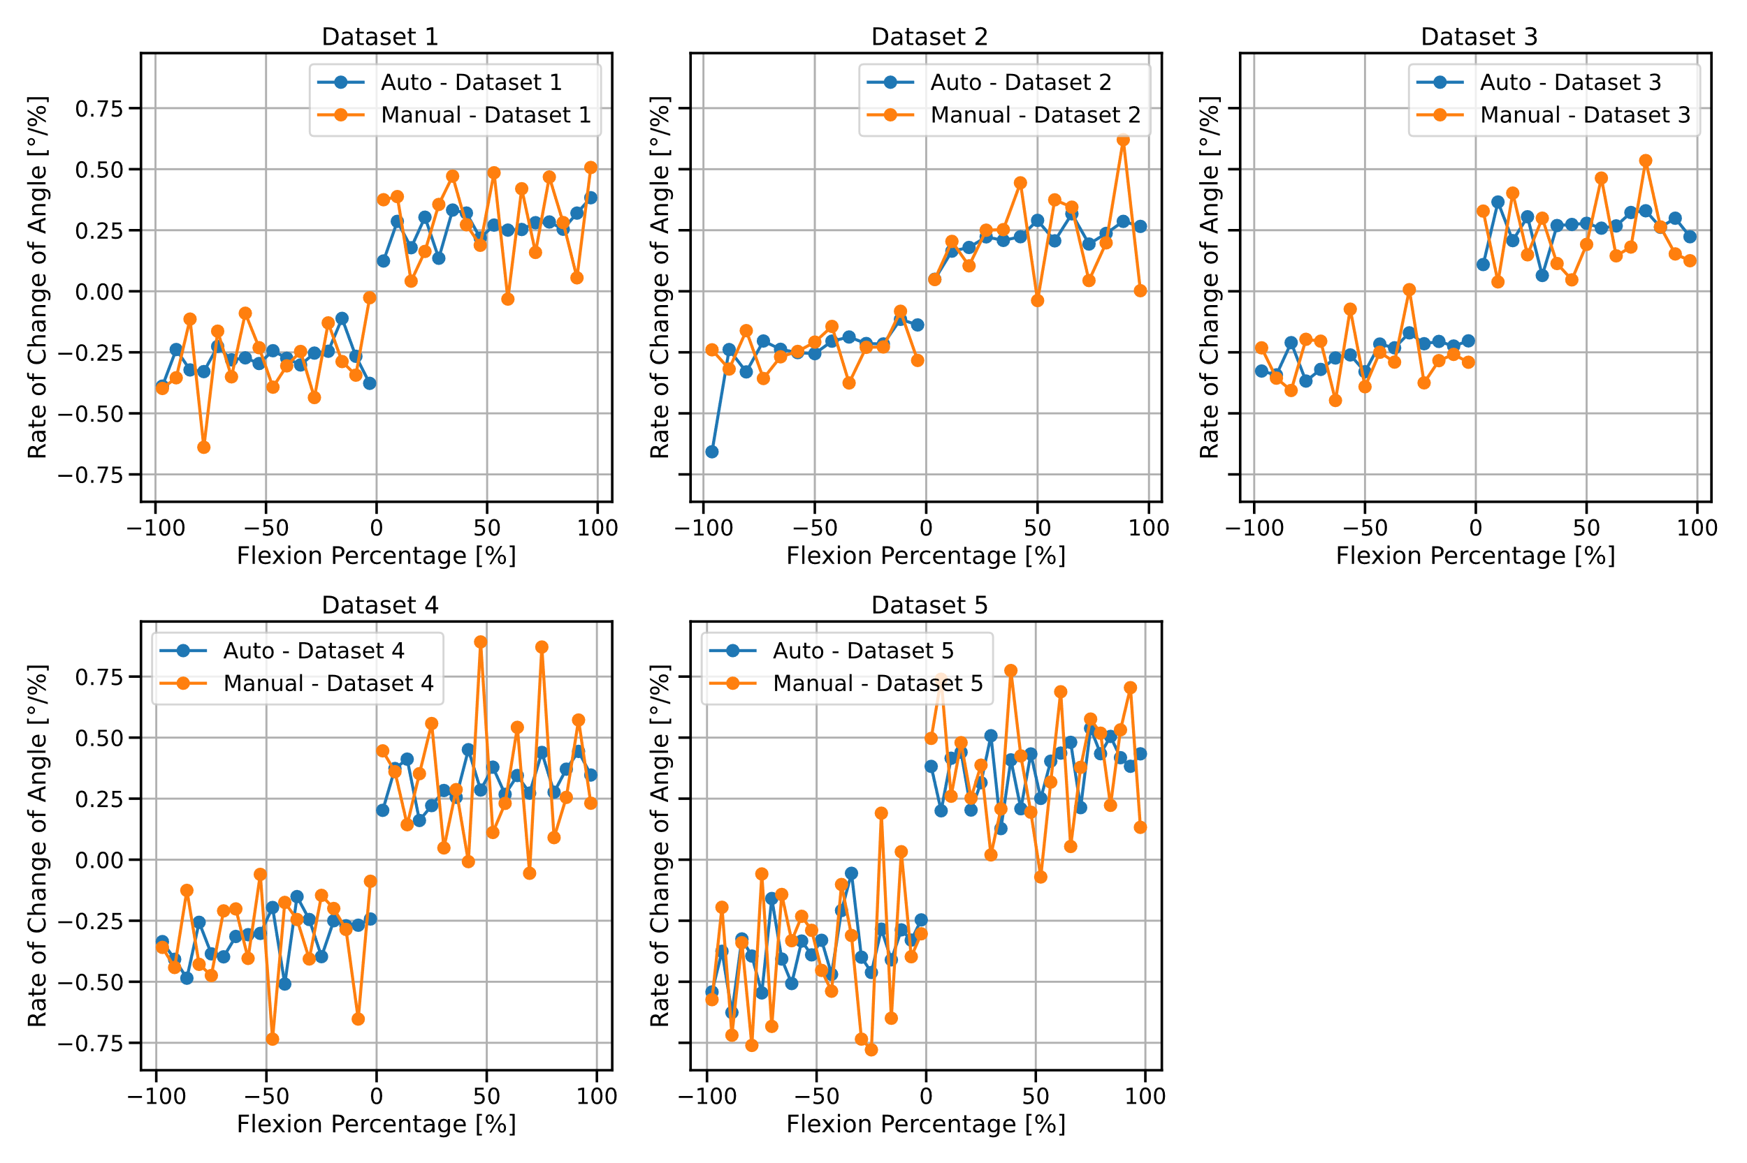
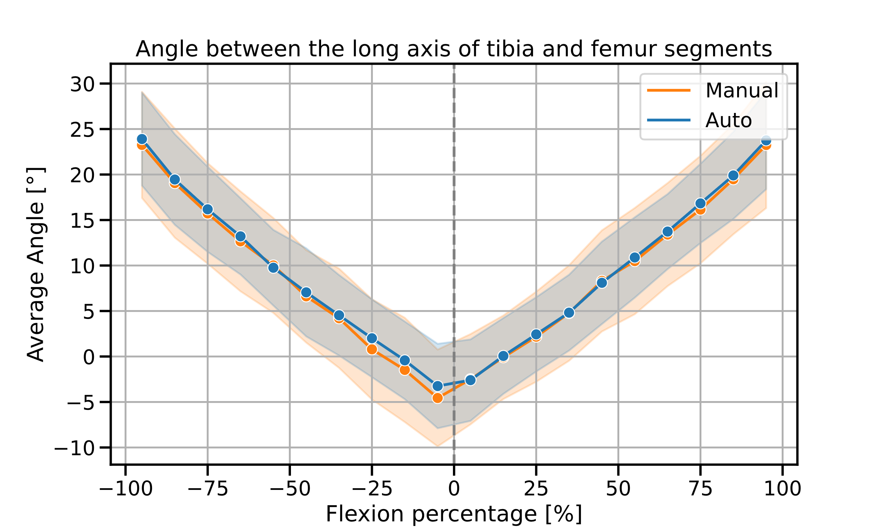
Development of a Semi-Automated Segmentation Pipeline for Dynamic MRI Analysis of Knee Joint Kinematics
Aayush Nepal¹, Nicholas M. Brisson^{2,3}, Georg N. Duda^{2,3},
Jürgen R. Reichenbach¹ and Martin Krämer¹
¹Medical Physics Group, Institute of Diagnostic und Interventional Radiology, Jena University Hospital, Friedrich Schiller University Jena
²Julius Wolff Institute, Berlin Institute of Health at Charité, Universitätsmedizin Berlin
³Berlin Movement Diagnostics (BeMoveD), Center for Musculoskeletal Surgery Charité, Universitätsmedizin Berlin
Synopsis
Accurate segmentation of the tibia and femur from dynamic MRI scans during knee flexion-extension can provide detailed insights into joint kinematics. Developing a semi-automated segmentation pipeline enables a streamlined approach to tibiofemoral kinematic analysis, offering potential advancements in clinical and research applications.
Introduction
This study utilizes a novel MRI-compatible device designed to facilitate controlled, repetitive knee flexion-extension cycles. Equipped with an optical sensor to synchronize motion data, the device enables the precise reconstruction of CINE MRI images that capture the knee during these movements, as illustrated in Fig. 1. Traditional kinematic analyses often rely on manually segmenting
each frame to track the tibia and
femur—processes that are not
only labor-intensive but also
prone to inaccuracies. To
address these challenges,
we developed a semi-automated
segmentation pipeline that
segments the tibia and femur
across the motion cycle with
minimal manual Intervention.
Fig. 1: CINE MRI of Knee Joint During Flexion-Extension Cycle
This figure displays selected frames from one reconstructed dataset of a CINE MRI sequence of the knee undergoing cyclic flexion and extension. The frames capture snapshots of the knee starting in flexion (Frame 0), reaching full extension (Frame 15), and returning to flexion (Frame 27). This dataset serves as a representative example of the image data used in the project, which was collected across multiple subjects.
Step (1)
Step (2)
Step (3)
Step (4)
Fig.2 Single frame of CINE data
Fig. 3 Canny Edge Detection
Fig. 4 Connected component labelling
Fig. 5 Establishment of reference points
Fig. 6 Application of transformation matrices
Methods
Results and Discussion
Volunteers underwent scans of the left leg as they actively com-
pleted repetitive, open chain knee flexion-extension cycles to the beat of a metronome (6 cycles/min), using a special
MRI safe device for guided knee motion. MRI was captured using a 2D radial golden angle gradient echo FLASH sequence. Cine
images were reconstructed, with each frame representing a 2° interval of knee motion using iterative and non-Cartesian reconstruction techniques. The semi-automated segmentation process was executed in five main steps on the first frame (Fig.2): (1) Canny edge detection was used to identify edges in the image for the tibia and femur (Fig.3); (2) connected-component labeling technique was used to pick out edges of the interior boundary of the cortical bone (Fig.4); (3) key reference points were established on the binary edge outputs, facilitating frame-to-frame transformations using greedy nearest neighbor sorting and cubic spline interpolation (Fig.5); (4) transformation matrices that map the position of the bone edge from one frame to the next were determined through optimization of a cost function. This function quantified the alignment error between subsequent frames by calculating the minimal distances between transformed and target coordinates. Optimization of this function was conducted by using the nonlinear least squares approach to obtain the optimal set of translation and rotation parameters; and these matrices were applied to the boundaries of the tibia and femur segments in the first frame, automating segmentation across the remaining frames in the motion cycle (Fig.6).
The tibia and femur were segmented twice: once using the semi-automatic pipeline described in the Methods section, and once manually. Using these segmented models, the angle between the tibia and femur was measured and compared across both methods, as shown in Figs. 7-9. The results clearly indicate that the semi-automatic segmentation outperformed the manual method, taking significantly less time and yielding more stable angle measurements. This is particularly important given the expectation of smooth leg motion inside the scanner. The automatic method better reflects this smooth motion, with fewer fluctuations in angular speed, whereas the manual method introduced greater variability. These findings suggest that this new approach is a suitable choice for performing other kinematic analysis on such datasets.
Fig.7
Fig.8
Fig.9
Fig.7 depicts the angle measurements between the long axes of the tibia and femur segments across five datasets. Each subplot compares the "Manual" (orange) and "Auto" (blue) methods, showing the relationship between flexion percentage and angle. Fig 8. depicts the derivative of the angle measurements from Figure 1, representing the rate of change of angle (or angular speed) with respect to flexion percentage for both the "Manual"
and "Auto" methods. The "Auto" method exhibits more stable values across all datasets, while the "Manual" method shows greater fluctuations, indicating less consistency in angular speed. The average angle between the tibia and femur segments across all five datasets, comparing the "Manual" and "Auto" methods. The shaded areas represent the standard deviation, with the "Manual" method showing a higher variance, particularly at the extremes of flexion, highlighting the greater consistency and stability of the automatic method.
References
1. Brisson NM, Krämer M, Reichenbach JR, Duda GN. A Device for Guide Knee Motion and Loading during Dynamic Magnetic Resonance Imaging: A Novel Device. Osteoarthritis and Cartilage 2021, Volume 29, S350 - S351
2. Brisson NM, Krämer M, Krahl LA, Schill A, Duda GN, Reichenbach JR. A novel device for guided knee motion and loading during dynamic magnetic resonance imaging. Z Med Phys 2021, under revision (ZMEDPHYS-D-21-00086)

